Slide 1
Donut Clicker
Group Members- Hao Nguyen, Alexander Gould, Pritam Roy

Slide 2
Work Distribution
Idea and JavaScript- Alexander Gould
HTML and Testing- Pritam Roy
CSS and Animation- Hao Nguyen

Slide 3
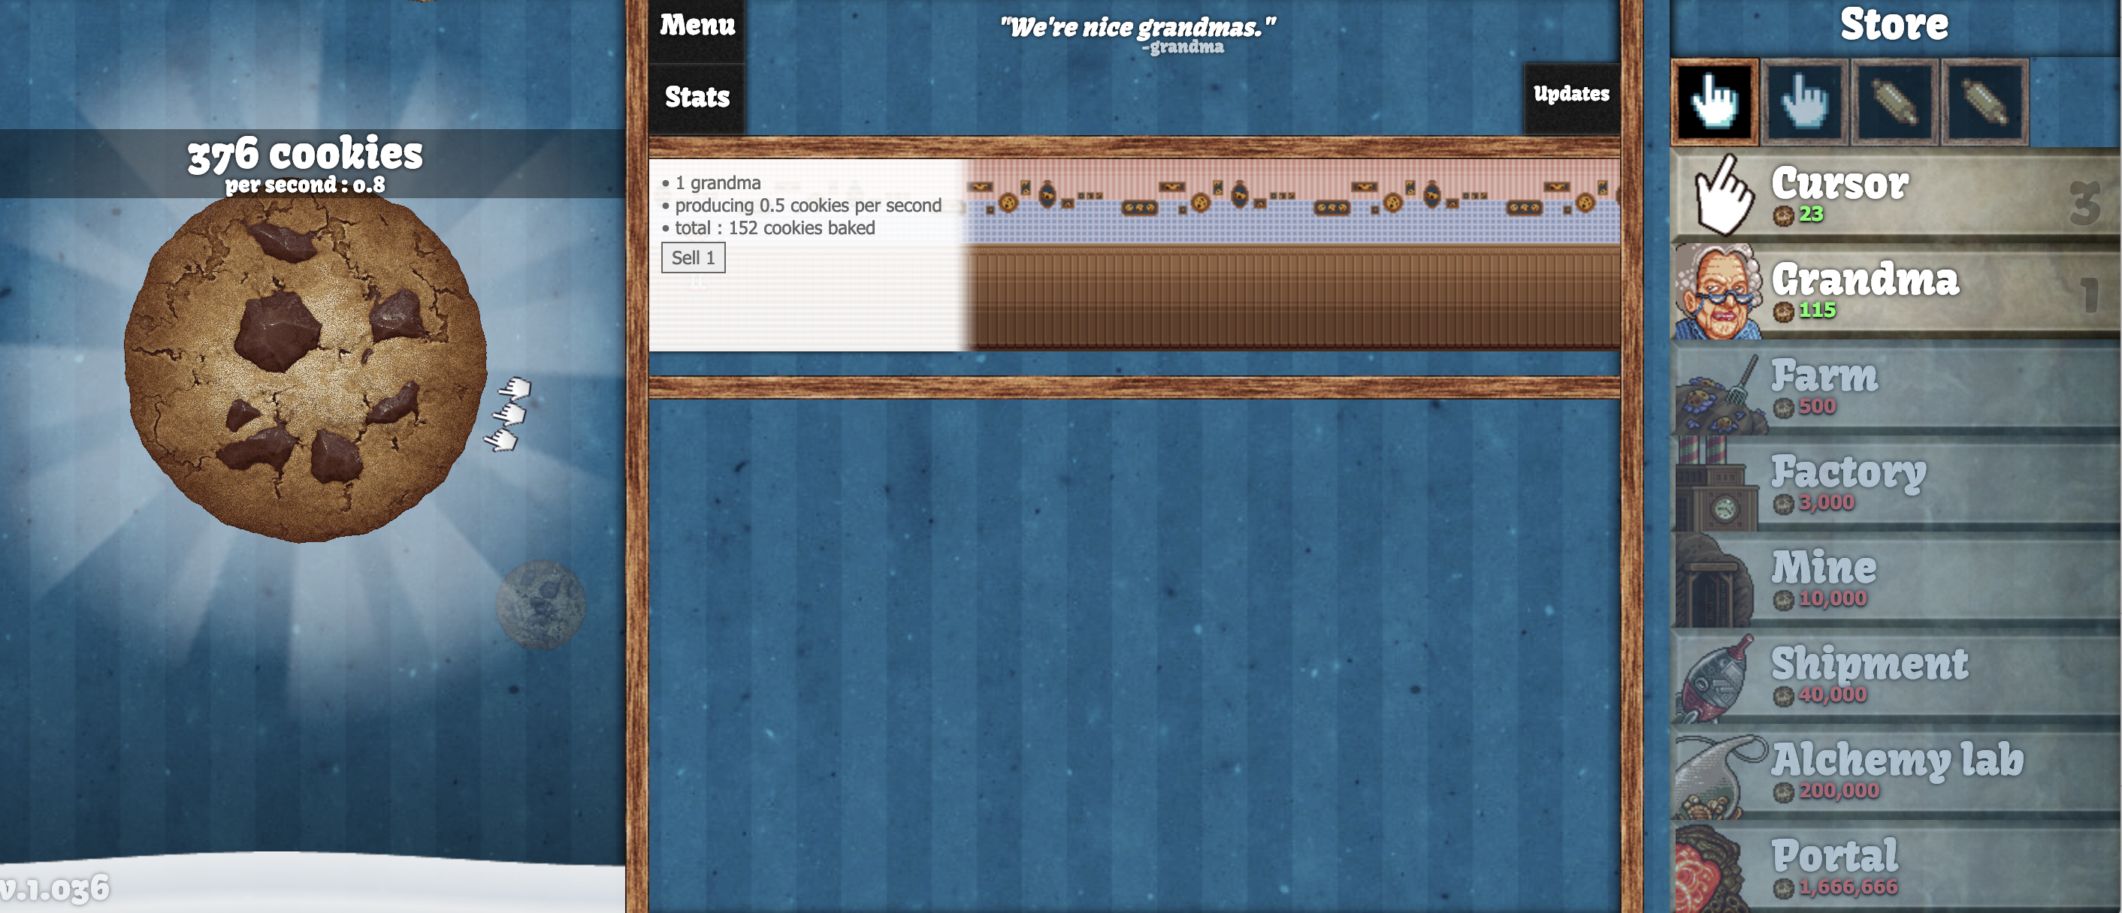
Cookie clicker

Slide 4
Our Project
- We wanted to create a game that is very addictive and fun
- After discussing so many topic we came up with this fun new game call Donut Clicker
- It is very similar to the game Cookie Clicker
-Instead of buying Grandma, Farm and Factory we give you some other things to buy and upgrade.

Slide 5
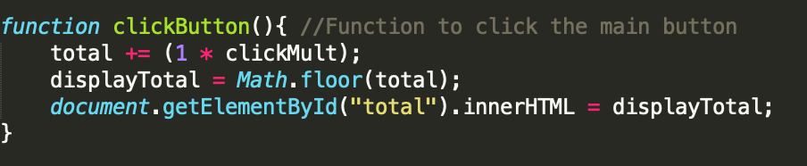
Click button function

Slide 6
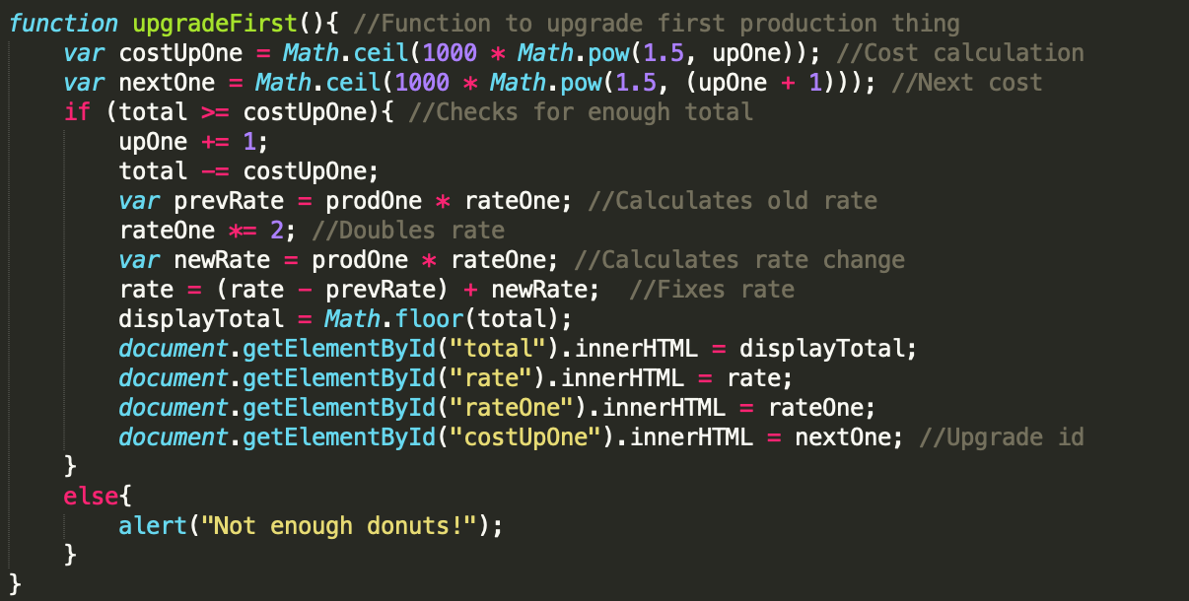
Upgrade first Function

Slide 7
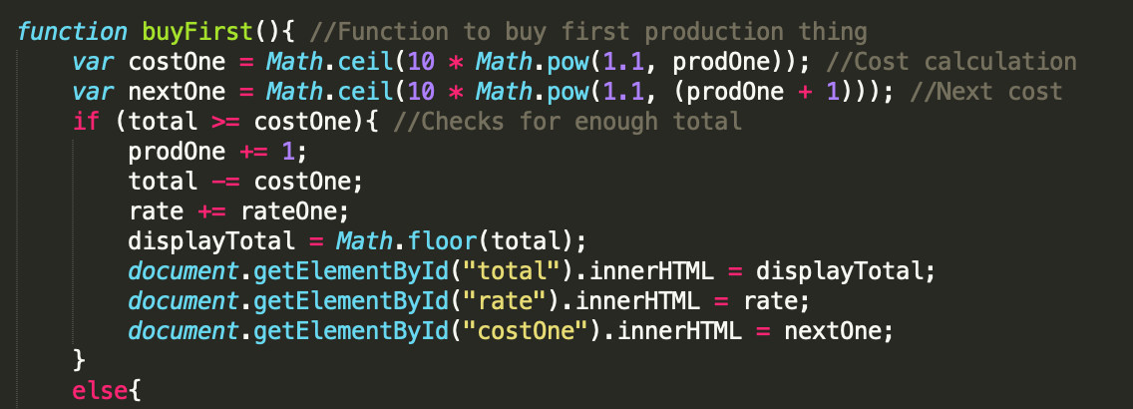
Buy first Function

Slide 8

Demo
http://codd.cs.gsu.edu/~proy3/Project2/

Slide 9

Q&A

